Slide 1
TOP TEN INTERNET SERVICE PROVIDER IN THE WORLD
PRESENTATION BY
IRFAN ALI QURESHI

Slide 2
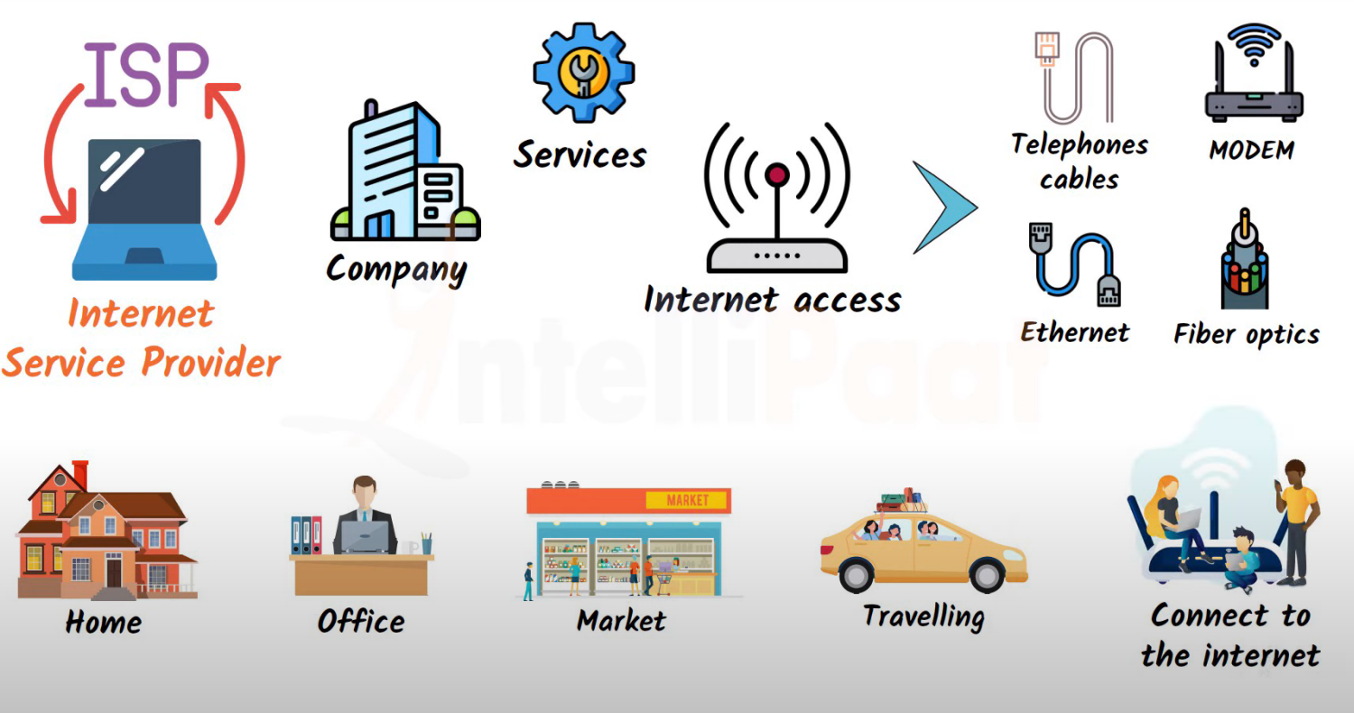
WHAT IS ISP ?

Slide 3
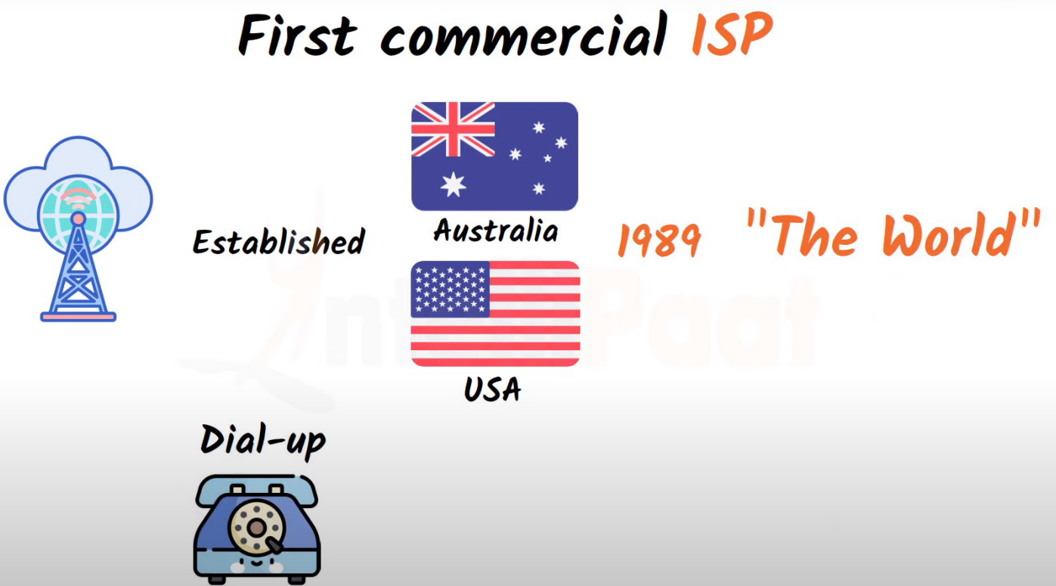

Slide 4
TOP 10 INTERNET SERVICE PROVIDER COMPANIES IN THE WORLD.
AT&T Internet
Verizon
Xfinity
Cox
Spectrum
Mediacom
Astound Broadband
CenturyLink, Frontier, and HughesNet (three-way tie)
Optimum
Viasat and Suddenlink

Slide 5
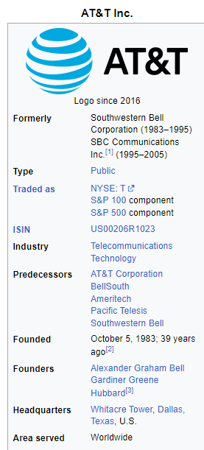
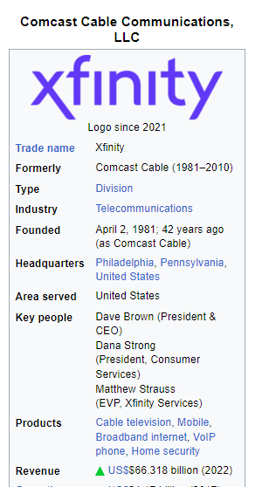
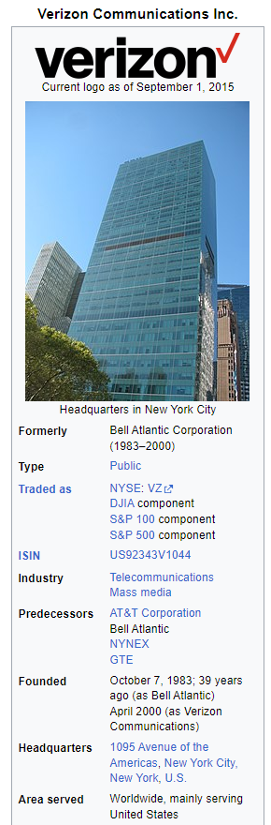
01
02
03

Slide 6
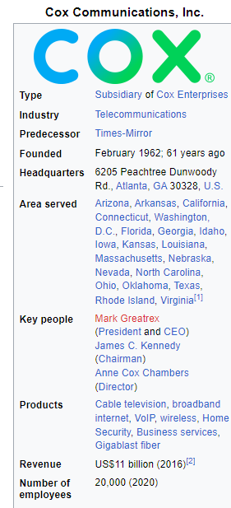
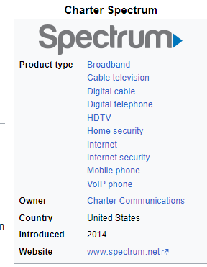
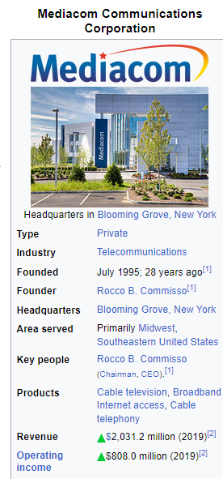
04
05
06

Slide 7
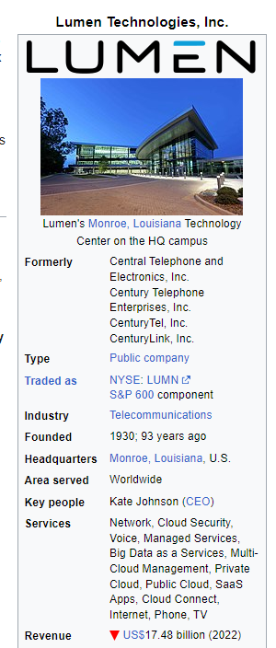
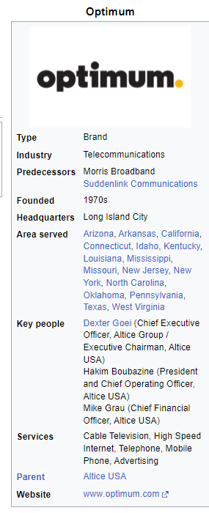
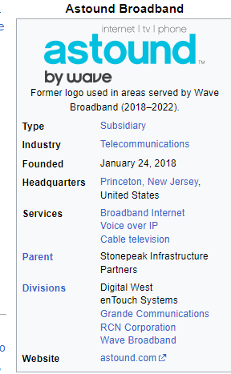
07
08
09

Slide 8
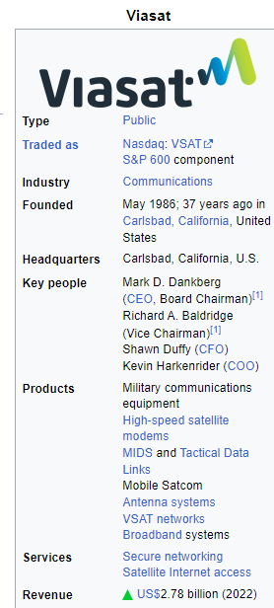
10
Viasat is an American communications company based in Carlsbad, California with additional operations across the United States and worldwide. Viasat is a provider of high-speed satellite broadband services and secure networking system covering military and commercial markets

Slide 9
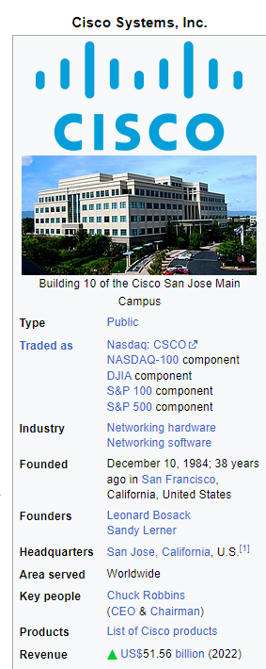
Cisco is a technology company that provides networking hardware and software products for the internet. Its products are used by internet service providers (ISPs) and other companies to manage and maintain their networks. Cisco's technology is essential for providing high-speed internet access and keeping networks running smoothly. In addition, Cisco's products and services help to secure and protect internet traffic. Overall, Cisco plays a critical role in the global internet ecosystem.

